Slide 1
Data Exploration on lodging market in Oswego County using R
By Minh Nguyen and Rabiu O Rabiu
Notes:
Minh: Hello everyone. I am Minh and this is Rabiu. Today we are going to talk about the project we’ve been doing since last semester. It’s about Data exploration on lodging market in Oswego County using R.

Slide 2
Data Package
Provided by Oswego County Community Development, Tourism, and Planning
9 different files: 4 excel files, 4 raw data files, 1 Oswego Zip Codes file.
4 excel files: work from a third party company
4 raw data files: 2 years, overlaps, no missing observations
Combined 4 files into 1 file, removed duplicates
Notes:
Minh: First, let’s talk about the data package. The data package was provided by Oswego County Community Development, Tourism, and Planning. It includes 9 different files: 9 different files: 4 excel files, 4 raw data files, 1 Oswego Zip Codes file. 4 excel files are work from a 3rd party company so we shift our focus to the 4 raw data files. each file has a time frame of 2 years. The time period is overlap in each file but luckily there were no missing observations, just a lot of duplication. Therefore, data organizing played a vital role in analyzing this topic. We combined 4 data raw files into 1 single file by removing duplicates

Slide 3
Data Set
371 Observations
34 variables
Time period: 2018-2021
1 region: Oswego County
4 subregions: Lake Shore, Oneida Lake, Salmon River, Tug Hill
2 providers: AirBnb and HomeAway
Note: sum(4 subregions) > whole region
Notes:
Minh: After combining, we got a data set containing 371 observations, 34 different variables. The statistics were recorded from 2018 to 2021. On each day, for each variables, there are 5 regions with Oswego County is the whole region and the rest are 4 subregions. For each region, there are 2 providers: Airbnb and HomeAway. Note that the sum of 4 regions may be > than the whole region due to some overlapping, possibly a room is counted more than once.

Slide 4
Goals of Data Exploration
Monthly traffic for each region including weakest to strongest month
Year to Year trends (Pre-covid, Covid and Post-Covid)
Length of stay
Revenue collected as rental income
Notes:
Rabiu: The Goals of the data exploration are as : Monthly traffic for each ……………

Slide 5
Data Cleaning
Analyze
Only analyze Airbnb using R
Time
Time Period: 2019-2021
Add
Add 2 more columns: Nights/Stays + Room Nights/Stays
Notes:
Rabiu:
We decided to analyze data just from Airbnb provider because we were unable to verify the Oswego County VRBO provider .
We began by analyzing data from 2019 as we were unable to gather sufficient data from 2018 making it impossible to view the monthly 2018 trends.
Add 2 more columns to get the number to work on length of stay.

Slide 6
Market Supply and Demand by Month
Available nights: Amount of nights that are available to be booked
Night booked: Total of guest occupied nights
Adjusted Occupancy rate: Percentage of available nights that have been booked
Notes:
Minh: Next, let’s analyze the first topic, Market Supply and Demand by Month. Before that, we should get to know some variables being used. …

Slide 7
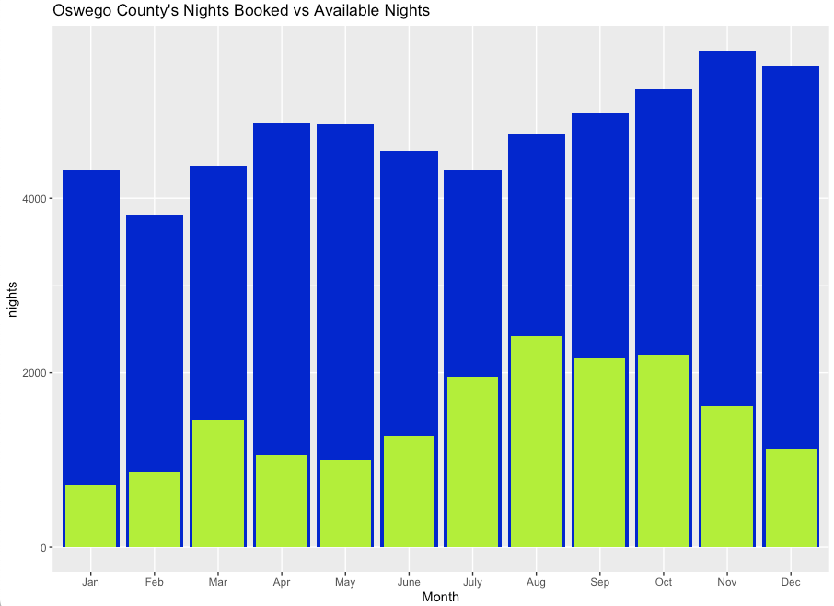
Market Supply and Demand by Month
5693
3811
2419
707
Notes:
Minh:
Now, on the board is the graph of Oswego County’s Nights Booked vs Available Nights. One interesting fact is that all of the graphs were made using ggplot2 package in R software. Looking at the graph, the blue column is Available Nights, and Night Booked is in neon color.
We can see that, Oswego County had averagely more than 4000 available nights each month. The highest month is November with 5693 nights, while the lowest was February with 3811 nights. The number of nights booked was picked in August with approximately 2500 nights, which accounted for 51% adjusted occupancy rate. The least busy month was January with only 16% of booked nights.

Slide 8
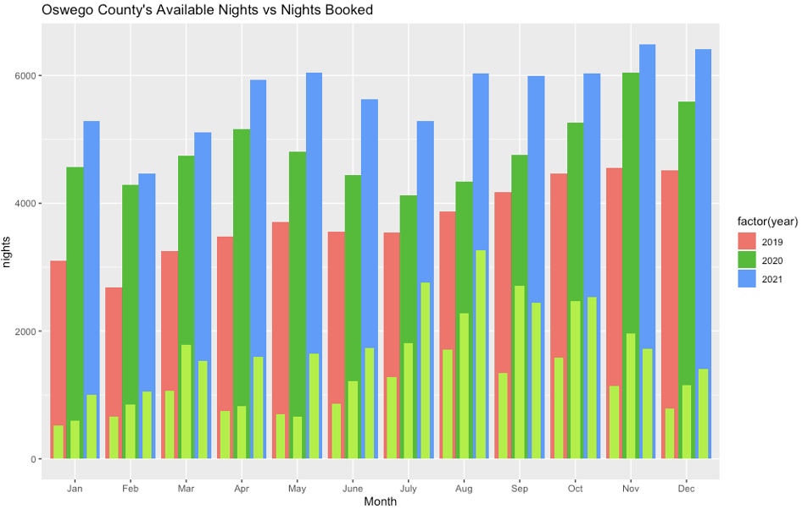
Market Supply and Demand by Month
5693
3811
2419
707
Notes:
Putting the average monthly and the monthly graphs side-by-side, we can see a similar pattern. November had the highest availability in each year and August is the busiest month.

Slide 9
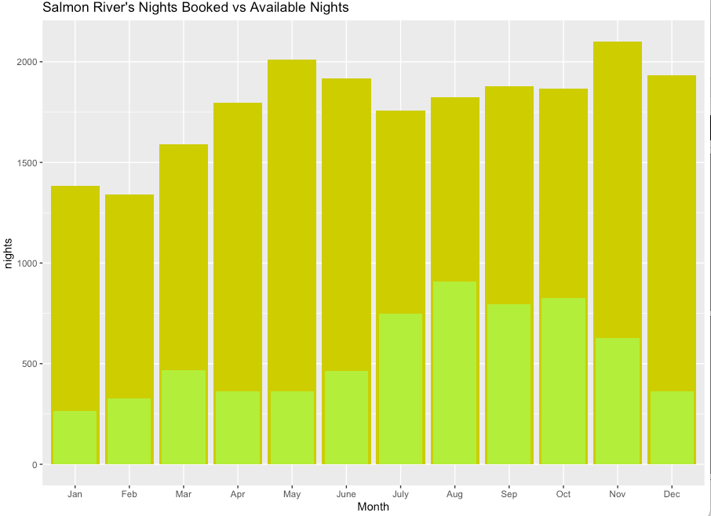
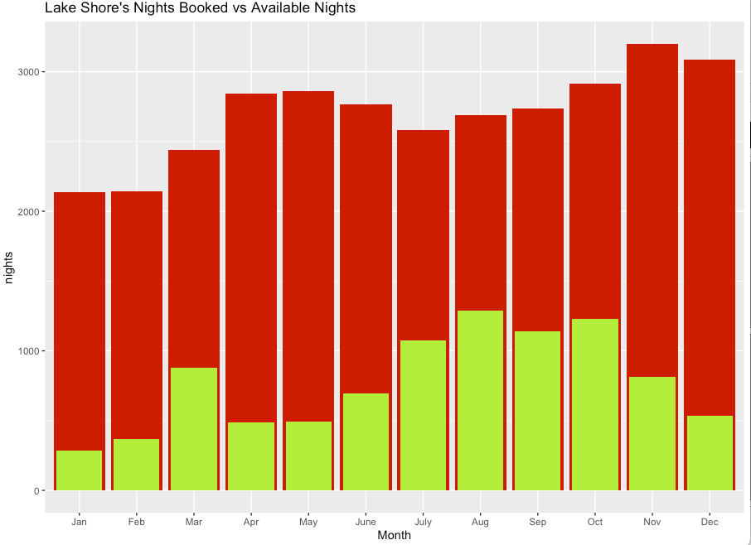
Market Supply and Demand by Month
2101
3200
1342
2142
909
1287
265
286
Notes:
Minh: 2 subregions Salmon River and Lake Shore had quite similar trend as Oswego County had. The highest number of monthly average available nights were 2101 and 3200 nights, respectively, recorded in November. February still had the least open nights of 1342 nights in Salmon River and 2142 nights in Lake Shore. The busiest months in both subregions are August with the occupancy rate of 50% and 48%. On the other hand, January had least booked nights with just less than 20% occupancy.

Slide 10
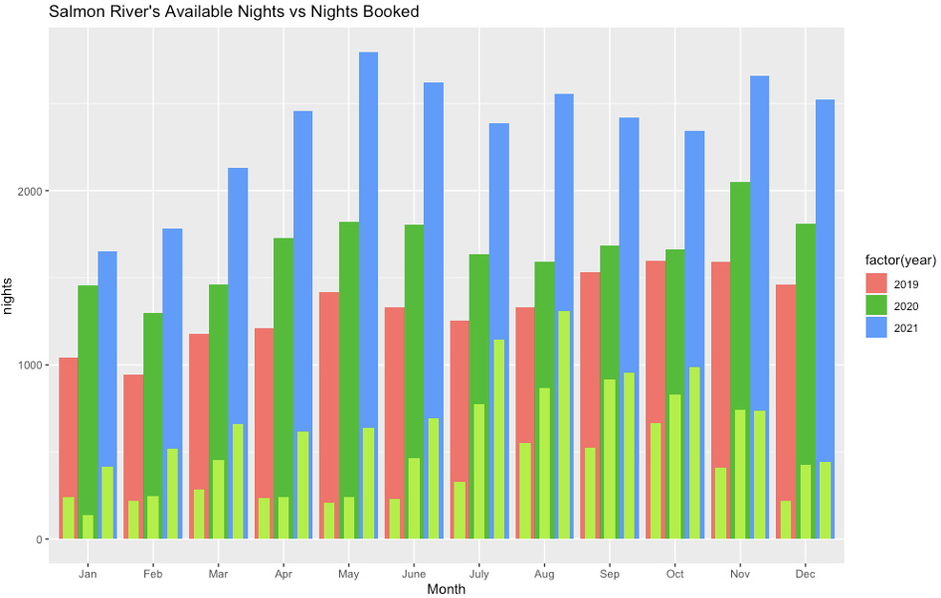
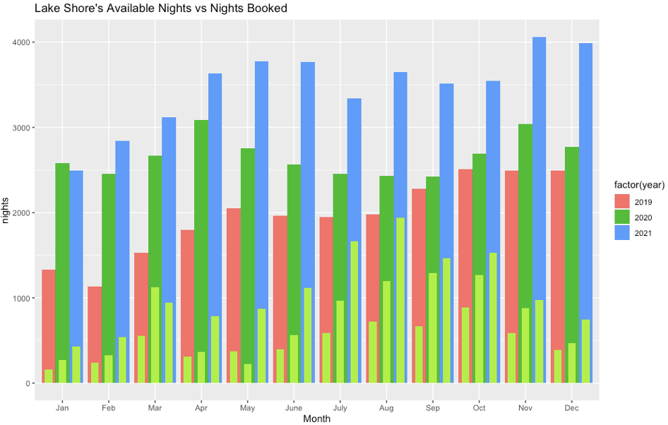
Market Supply and Demand by Month
Notes:
Same as Oswego County, the graph of monthly Available nights vs Nights Booked in these regions also had the same trends as the average monthly plots.

Slide 11
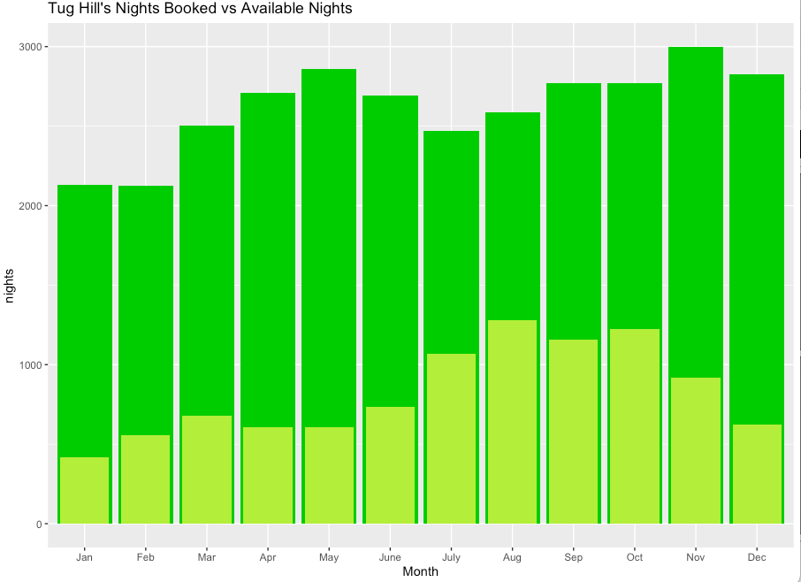
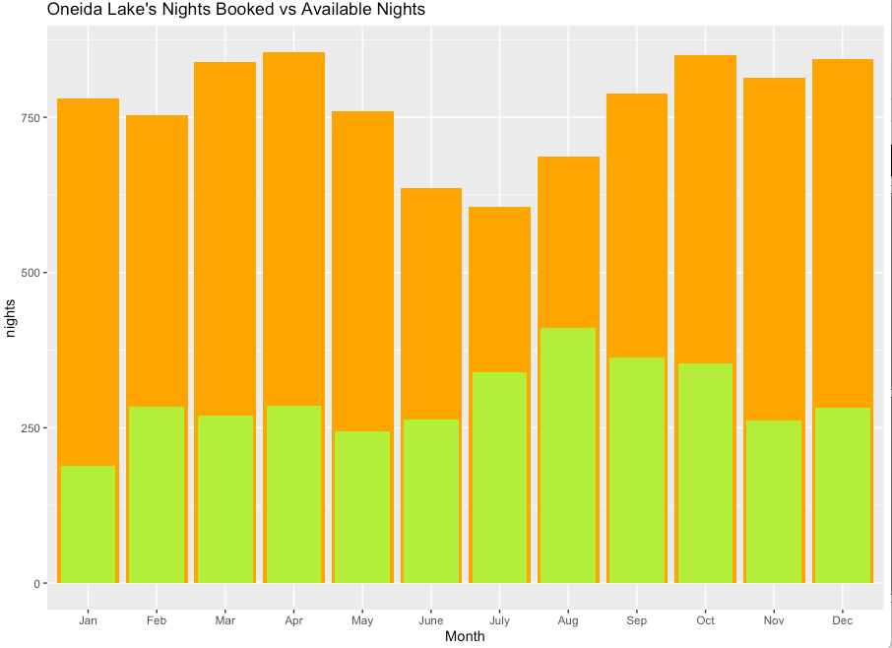
Market Supply and Demand by Month
2999
855
2124
606
410
1279
188
420
Notes:
Minh: The last two regions, Tug Hill and Oneida Lake had the highest availability of 3000 and 855 nights in November and April, respectively. The most booked nights were recorded in August of 1279 and 410 in each region. The February in Tug Hill had least availability and but least booking was January of less than 20% of occupancy rate. While in Oneida Lake, July had the lowest available nights of just 606 nights, but January had the lowest occupancy rate of 24%.

Slide 12
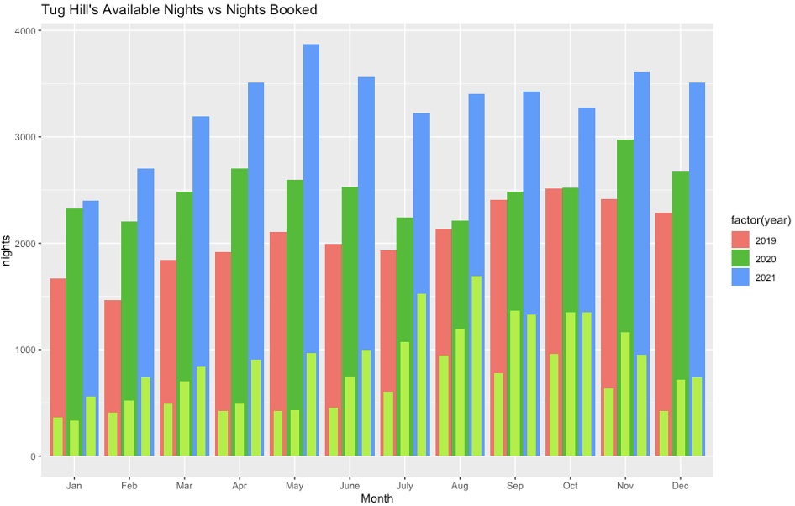
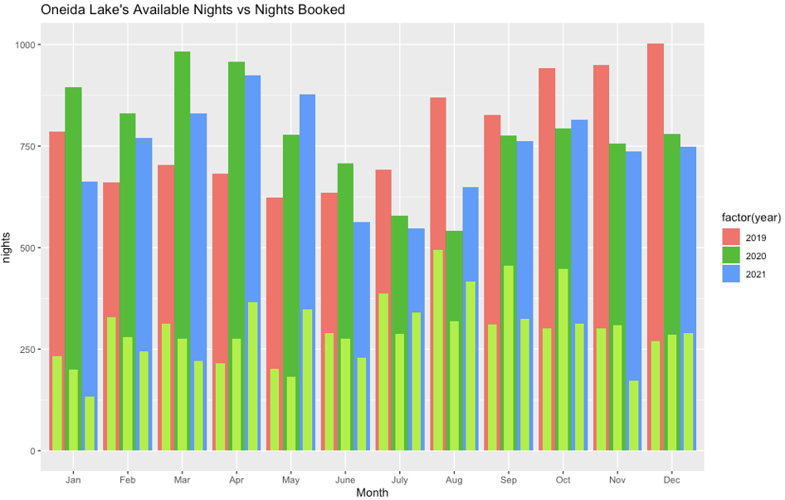
Market Supply and Demand by Month
Notes:
If you look carefully, you can see that Oneida Lake had strange pattern compared to other subregions. The graph of monthly available nights vs nights booked also showed that. For some months, the number of availability and booked nights in 2019 are higher than those of 2021, specifically in the second half of the year.

Slide 13
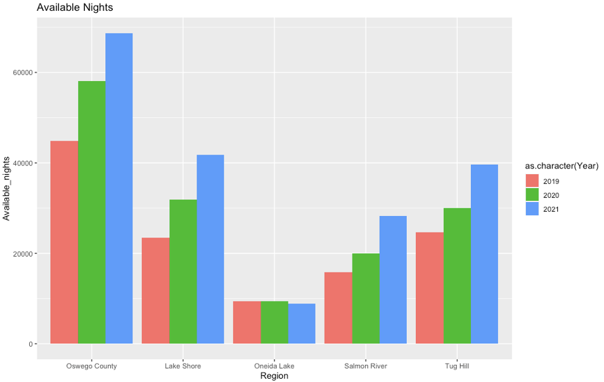
Year-to-year market trend
for Available Nights
68720
58109
44887
41733
39698
31921
28320
29956
24684
23512
19997
15889
9374
9373
8886
Notes:
For Available nights which is: Amount of nights that are available to be booked
Oswego County had available nights with approximately 68720 nights available. The number started at 44887 available nights in 2019, then increased to 58109 nights for 2020, then finally increasing to 68720 available nights for the year 2021. Oneida Lake region had the least amount of nights available with only 9374 nights available for 2019, 9373 nights available for 2020 and then a huge decrease to 8886 nights available for 2021. Tug Hill was seen to have similar pattern as Lake Shore. Salmon River had 15889 available nights for 2019 , 19997 available nights for 2020 and finally jumped up to 28320 available nights for 2021. In general , despite the Covid, the number of available nights has been increasing from year to year except for the Oneida lake region.

Slide 14
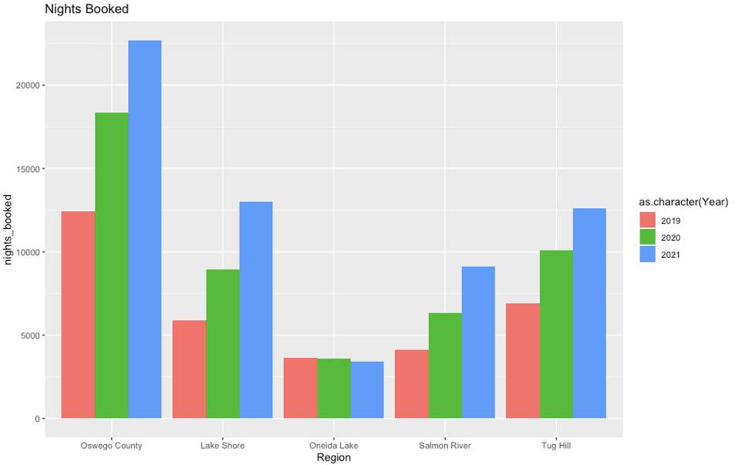
Year-to-year market trend
22698
18339
12415
13019
12607
10109
8941
9120
6334
6918
5905
3650
4115
3588
3399
Notes:
Rabiu: It is no surprise that Oswego County nights booked increased from year to year. It started at 12415 nights booked in 2019 that went up to 18339 nights booked for 2020 then finally increased again to 22698 nights booked for 2021.. Lakeshore, Oneida Lake, Salmon River, Tug hill
all followed the same pattern as the graph for available nights. Oneida Lake
had the least nights booked with only 3650 nights booked for 2019, 3588 nights
booked for 2020 and finally 8886 nights booked for 2021.In general , yearly nights booked followed the same pattern as available nights for each of the regions.

Slide 15
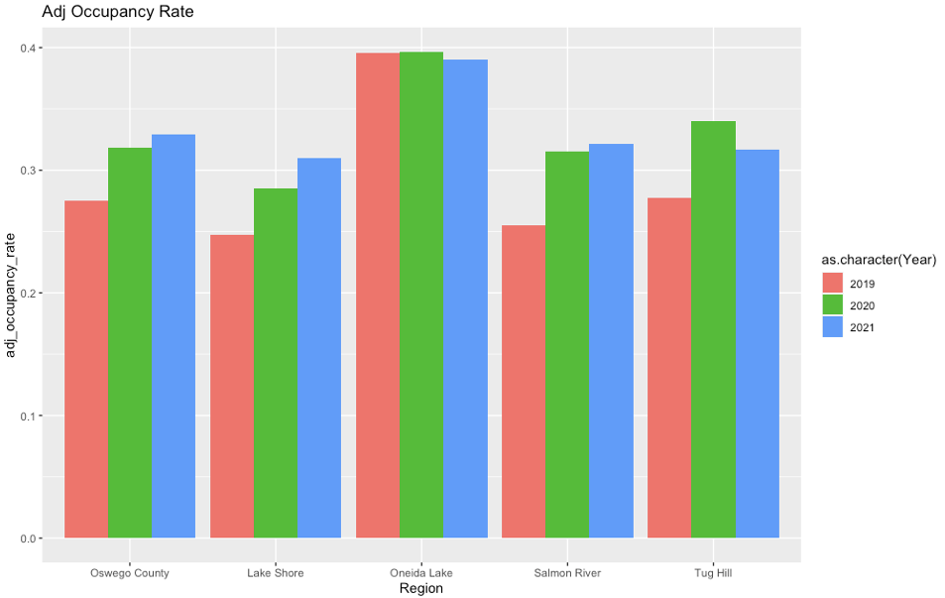
Year-to-year market trend for Adj Occupancy rate
(Percentage of available nights that has been booked)
39.66
39.56
39.00
32.92
32.16
33.96
31.80
30.96
31.49
31.70
27.47
28.55
27.71
24.74
25.51
Notes:
About occupancy rate, four regions: Oswego County, Lake Shore, Salmon River, and Tug Hill had quite similar numbers in the 2019-2021 period. The number fluctuated between 24.74% and 33.96%. The Oneida Lake had a high occupancy rate with 39.56% in 2019, 39.66% in 2020, and 2021 was 39.00%.These group of numbers suggest that regions lake Shore, Salmon river and Tug hill have similar behaviors, these three regions mostly determined the big picture for the Oswego County.

Slide 16


Length of Stay
Average Nights per Book: Nights per Stay
Average Room Nights per Book: Room Nights per Stay
Notes:
Average Nights per book is the Average number of unique nights per booking within the reporting period
Average Room Nights per book is the average number of room-nights booked within the reporting period. Sum of bedrooms per booked listing

Slide 17
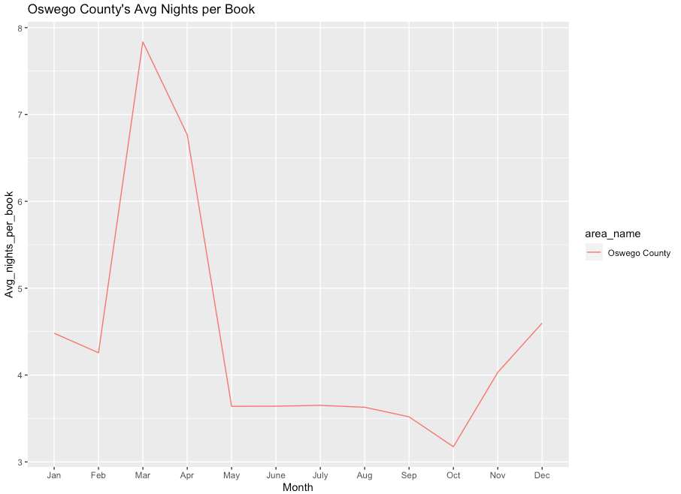
Length of Stay
7.835
3.175
Notes:
Looking at the time series graph Oswego County Avg night per book had its highest avg night per book in the month of March with about 7.835 nights and its lowest month in October with about 3.175 nights per book. It is important to note that this graph is the monthly average for each Oswego County.

Slide 18
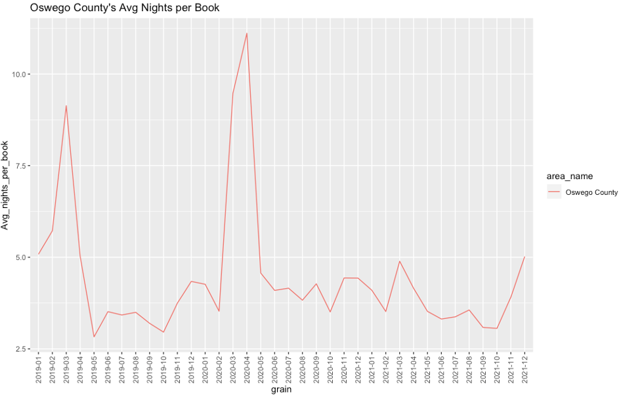
Length of Stay
Notes:
This time series graph illustrates the Monthly average night per book

Slide 19
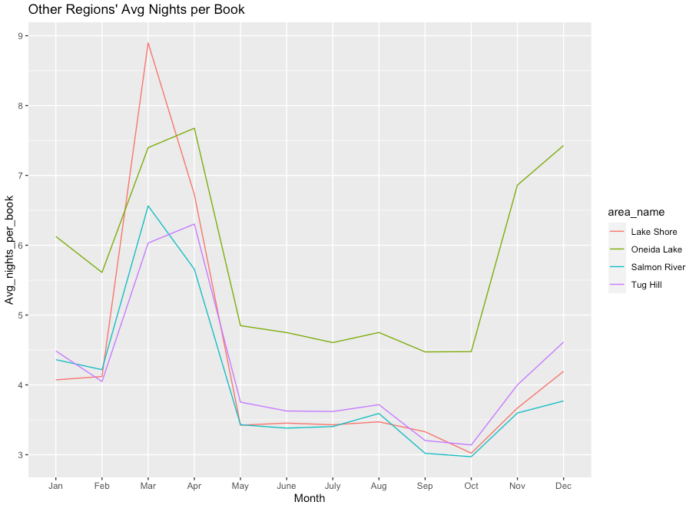
Length of Stay
8.9
2.97
Notes:
Looking at the time series graph For other regions Lake Shore was higher that the other regions with March being the month that had the highest Avg nights per book with 8.90 nights per book. Salmon River had the least Avg nights per books of all the regions. October had the least avg nights per book recorded for Salmon River with approximately 2.97 nights per book.

Slide 20
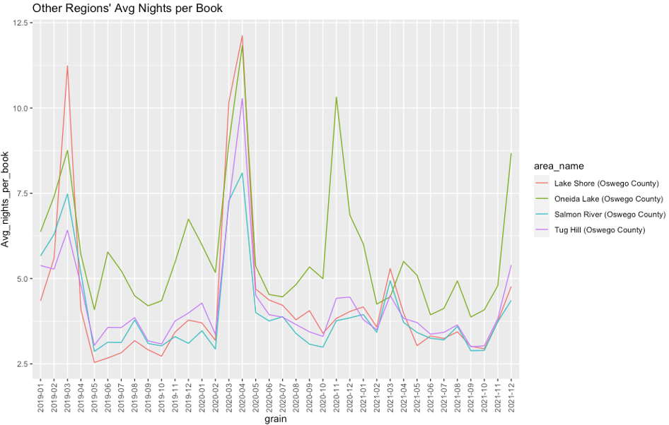
Length of Stay
Notes:
Time series graph here shows the other regions avg nights per book for the time period january 2019 to december 2021.

Slide 21
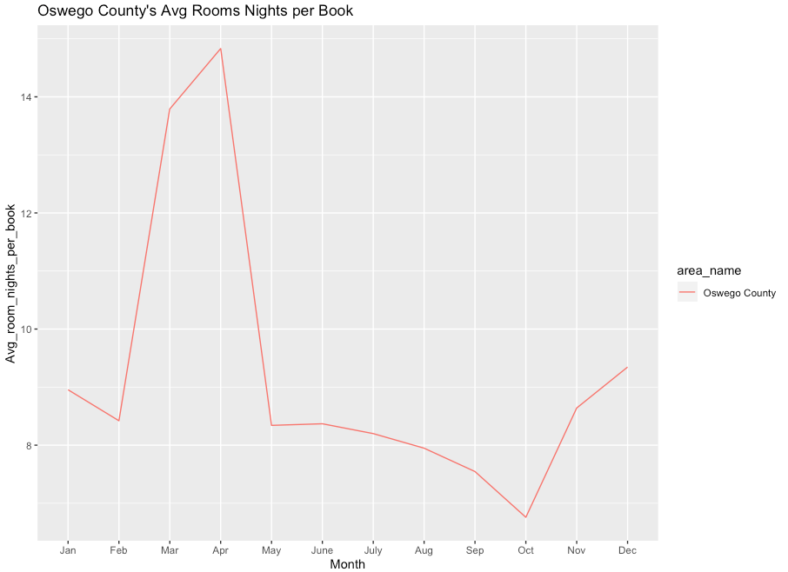
Length of Stay
14.831
13.79
6.758
Notes:
Looking at the time series graph For Oswego County’s Average room nights per book the months of March and April were the highest with 13.79 nights for March and 14.831 nights for April. The lowest Average room nights per book occurred in the month of October with 6.758 room nights per book. The difference between avg room nights and nights per book is simply that the number of rooms booked was higher than the number of nights booked.

Slide 22
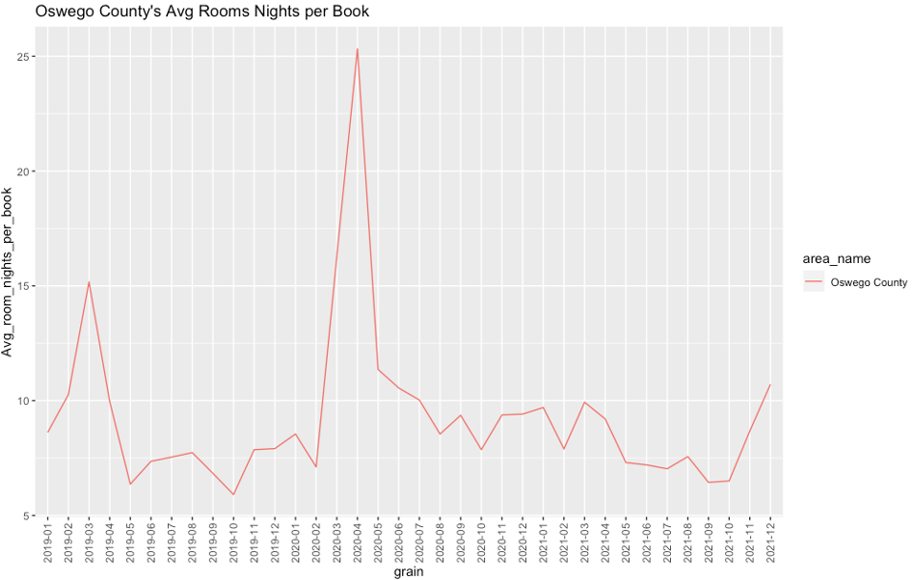
Length of Stay
Notes:
Time series graph here shows the Oswego county regions avg room nights per book for the time period january 2019 to december 2021.

Slide 23
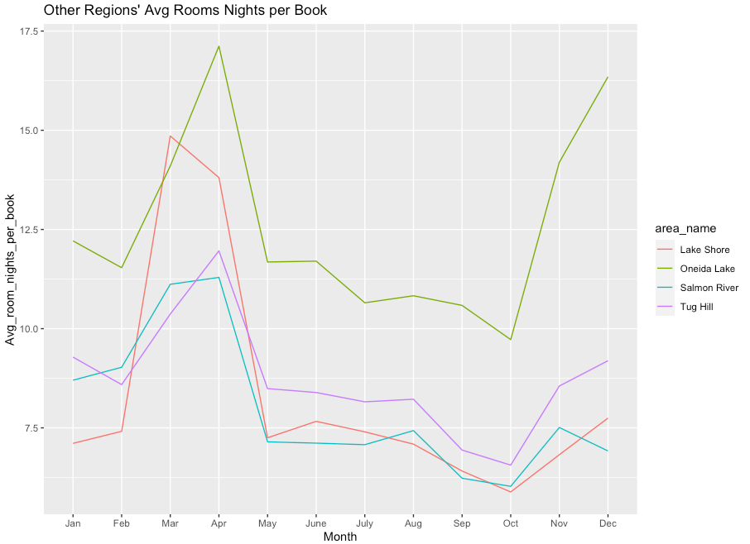
Length of Stay
17.11
5.88
Notes:
When looking at the other regions avg room nights per book Oneida lake had the highest avg room nights per book compared to other regions. Oneida lake had April as it highest month with approximately 17.11 avg room nights per book. Lake shore had the lowest average room nights per book of all the other regions. Lake shore had its lowest month in October with with its average room night per book at approximately 5.88 nights.

Slide 24
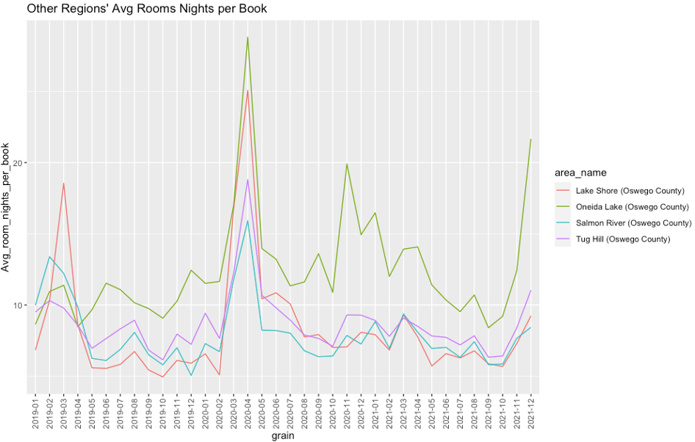
Length of Stay
Notes:
Time series graph here shows the other regions avg room nights per book for the time period january 2019 to december 2021.

Slide 25



Revenue
Gross Revenue: Sum of transactions for all stayed nights, or actual revenue generated
Adjusted Revenue per Available Listing: Average revenue per available listing adjusted for blocked nights.
Adjusted Revenue per Available Room: Average revenue per available room adjusted for blocked nights.

Slide 26
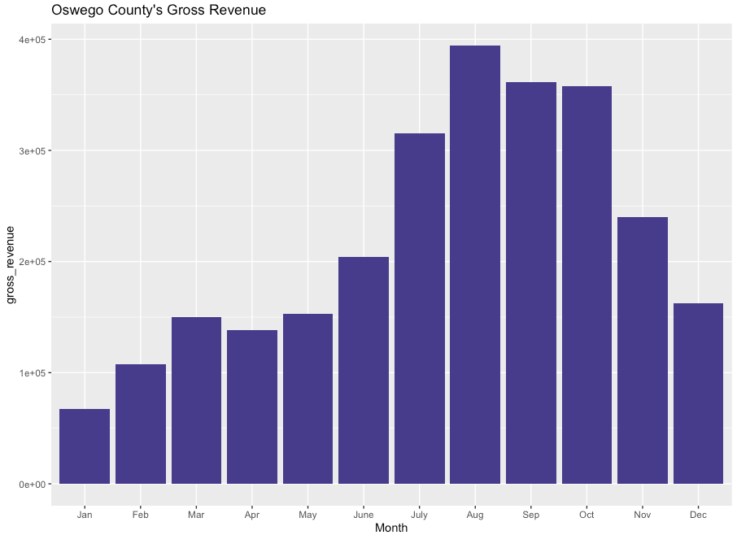
Monthly Gross Revenue
394428
67542
Notes:
Minh:
Oswego County’s highest revenue was noted in August with roughly 394428 thousand dollars. While the lowest month was January having only 67542 thousand dollars, we can see a huge range between the most and the least earned.

Slide 27
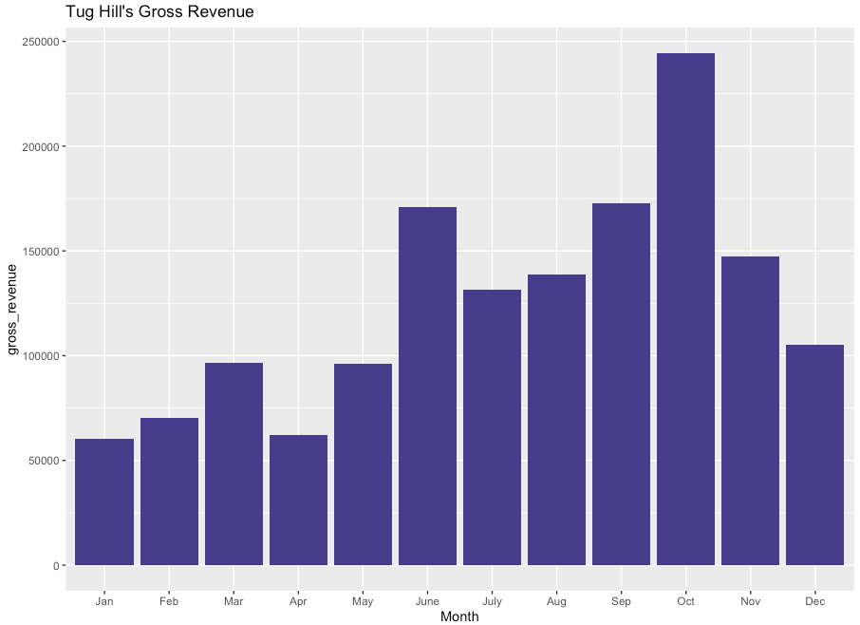
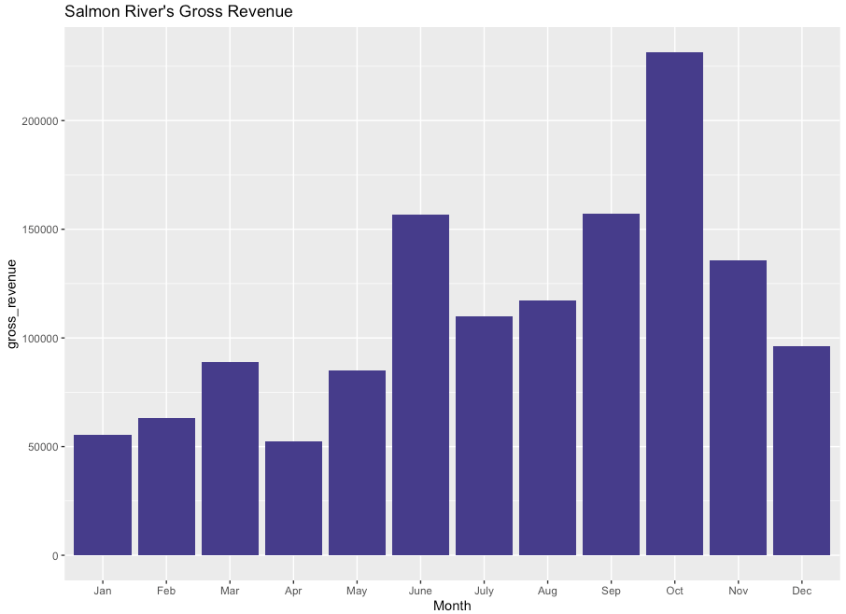
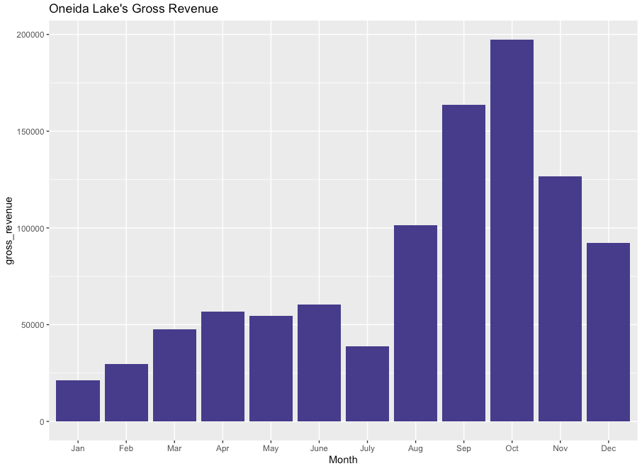
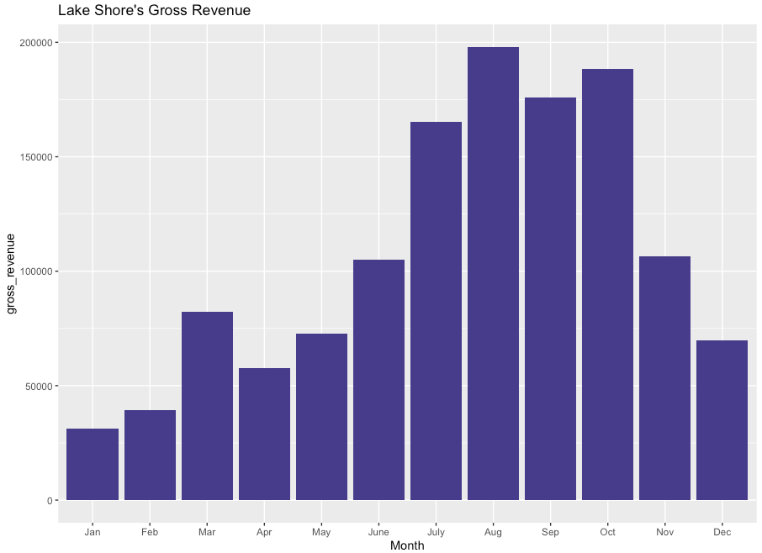
Monthly Gross Revenue
244415
231490
60429
31409
197353
197973
21386
55522
Notes:
Minh:
Among the four subregions, Tug Hill had the highest revenue. This number was recorded in October with 245 thousand dollars. Salmon River and Oneida Lake also had the peak revenue in October with 232 thousand and 198 thousands dollars respectively. Lake Shore also had the similar peak revenue as Oneida Lake had, except for this number was earned in August. The weakest earning months for all of these subregions were in January with Tug Hill had 61 thousand, 56 thousand in Lake Shore, Salmon River was 32 thousand, and the lowest was Oneida Lake with 22 thousand dollars.

Slide 28
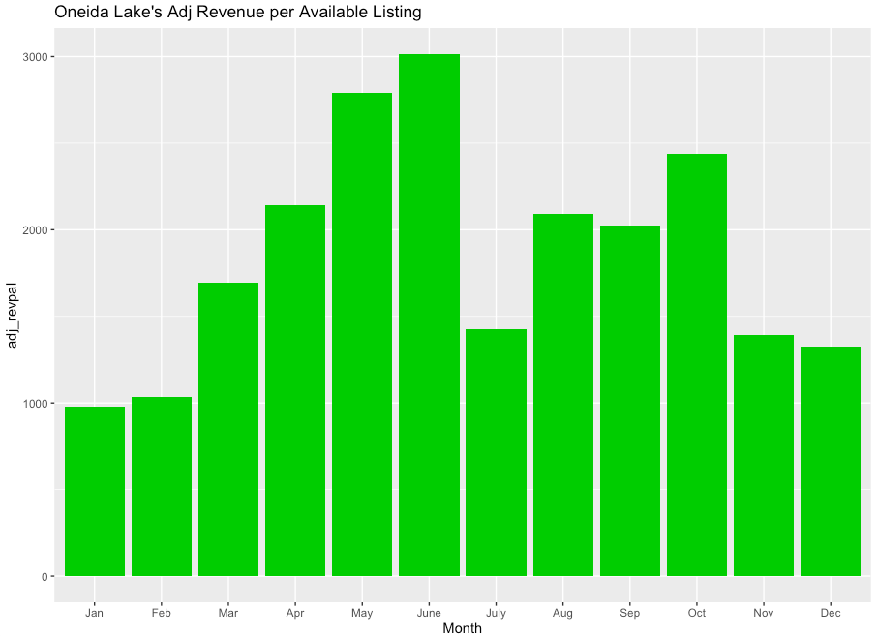
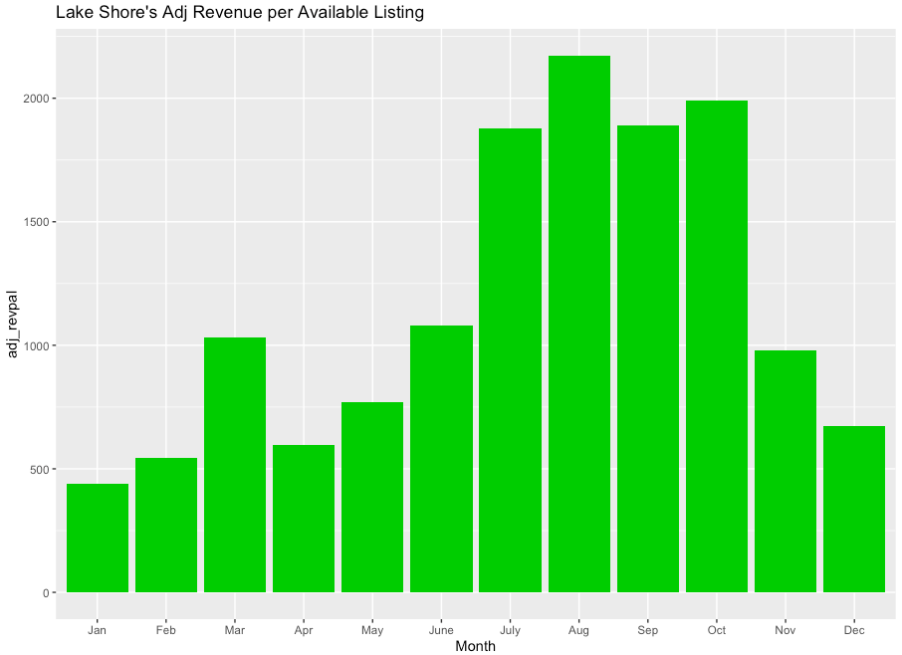
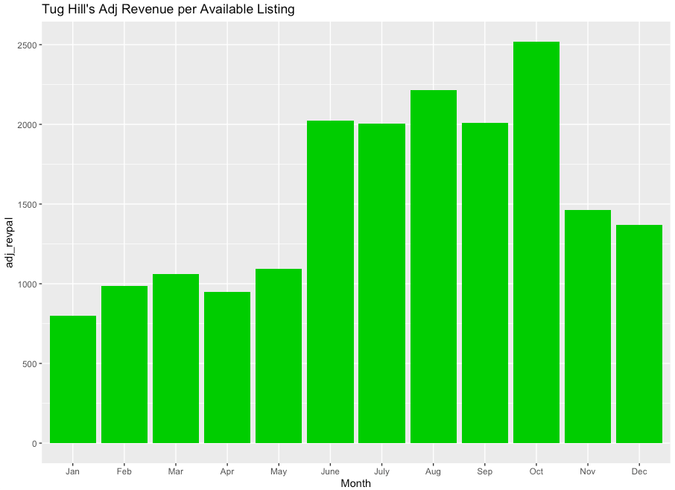
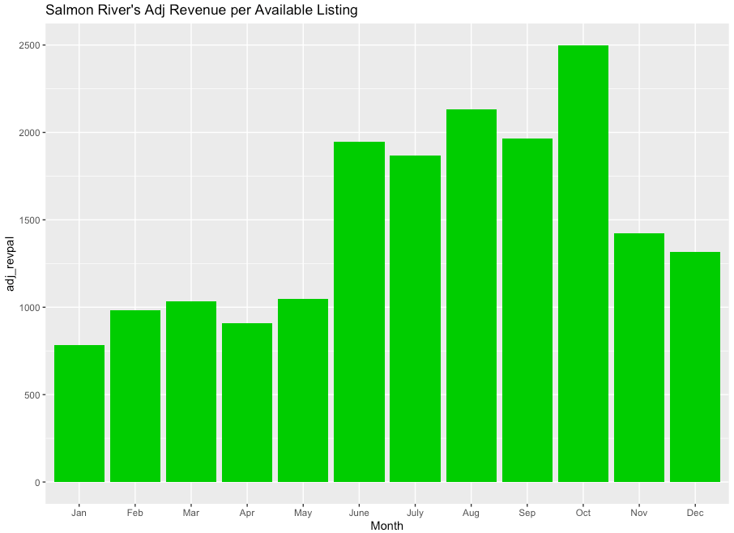
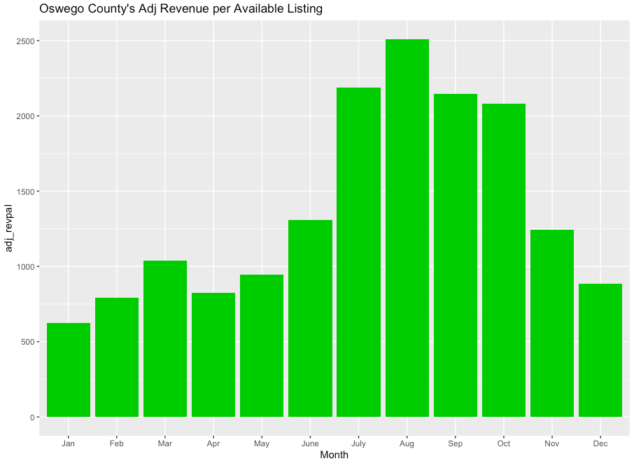
Monthly Adjusted Revenue per
Available Listing
3015
2173
977
441
2520
2499
2510
801
783
622
Notes:
Minh:
For all of the regions, the weakest average revenue per listing fell in January. The number was ranging from 442 dollars to nearly 1000 dollars. Some subregions even outnumbered Oswego County such as Oneida Lake had more than 3000 dollars and Tug Hill had 2520 dollars compared to 2510 dollars of Oswego County. Lake Shore and Salmon River had lower revenue per listing than Oswego County but the number was not far away with 2173 dollars and 2499 dollars, respectively.

Slide 29
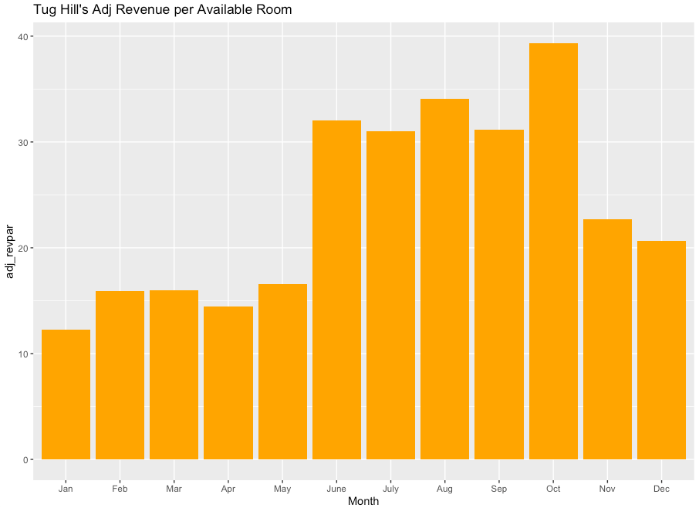
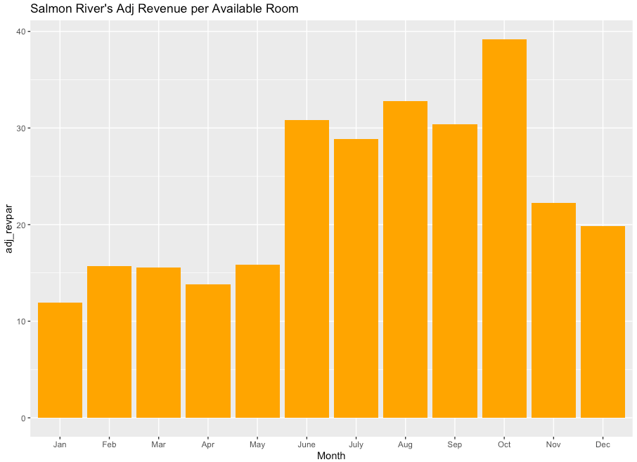
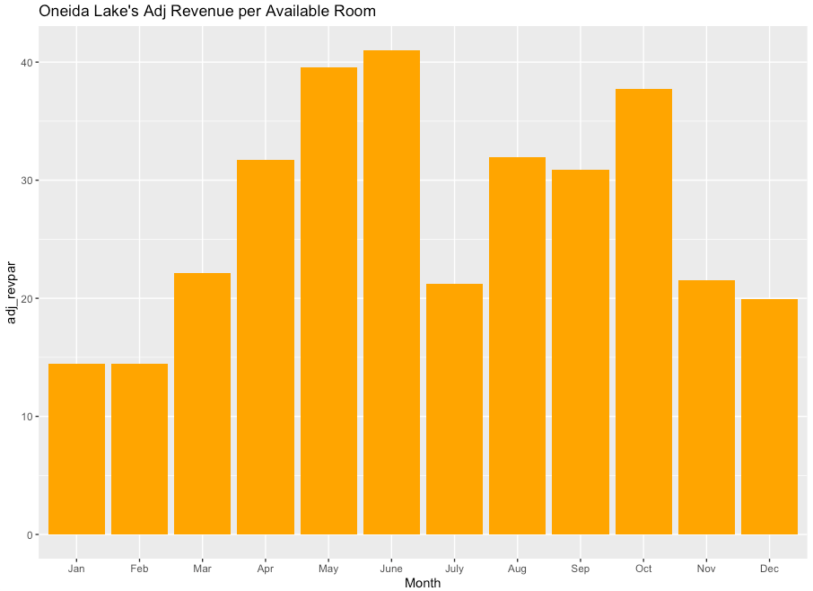
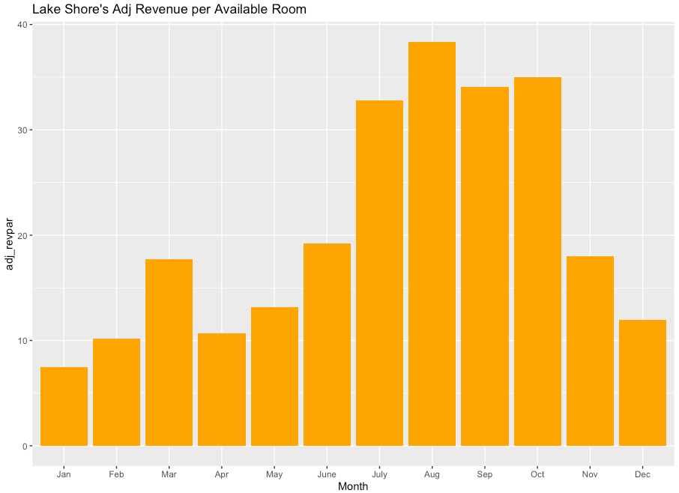
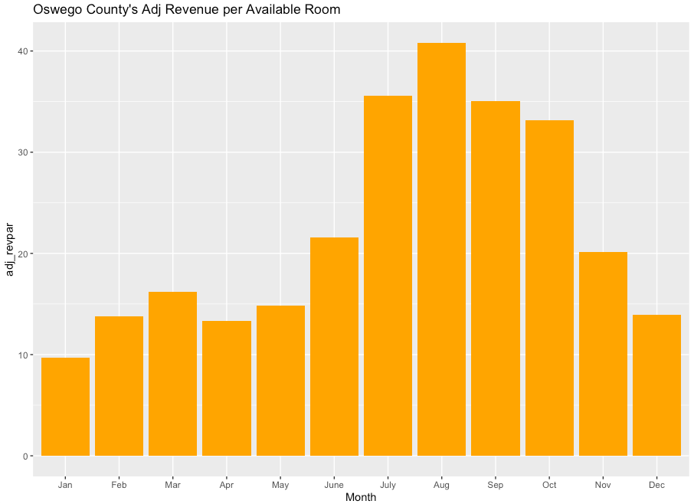
Monthly Adjusted Revenue per Available Room
39.34
39.19
12.25
11.93
39.58
38.35
40.81
14.49
7.5
9.66
Notes:
Minh: Next, we analyzed monthly adjusted revenue per available room. This number will be much smaller than the monthly adjusted revenue per listing that we looked at above. The reason for this was that this is the average earning for each room, and one listing may have more than one room available to be booked. Looking at the graphs, each region and subregion had quite similar highest numbers with approximately 40 dollars per room recorded in August and October. The least earning month was still January with the number ranging from 7.5 to 15 dollars per room and Lake Shore had the lowest revenue among five region and subregions.

Slide 30
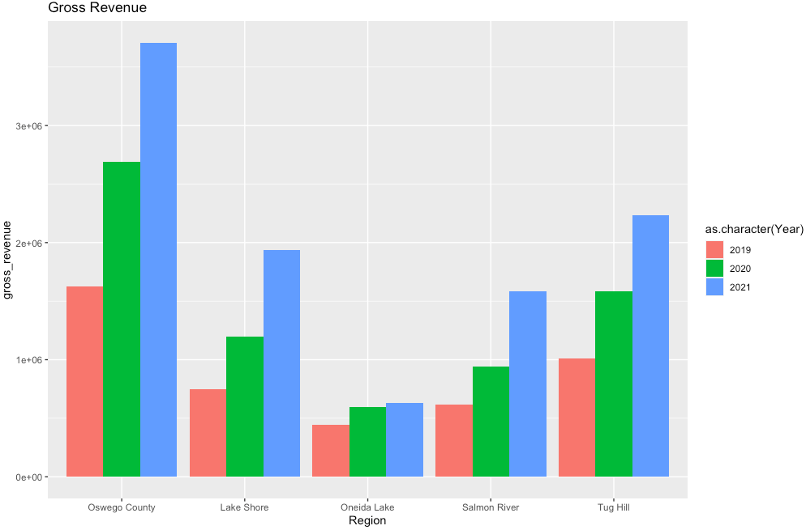
Year-to-year Gross Revenue
3.71
The Gross revenue is the sum of transactions for all stayed nights, or actual revenue generated.
2.69
2.24
1.93
1.63
1.59
1.59
1.20
0.94
1.01
0.75
0.63
0.62
0.59
0.45
Notes:
In Oswego County, the total gross revenue increased year-by-year. For 2019 the revenue recorded was approximately 1.6 million dollars. Then it went up sharply till nearly 2.7 million dollars in 2020 before reaching the peak of roughly 3.7 million dollars in the end of the 3-year period. Other counties followed a similar upward trend.

Slide 31
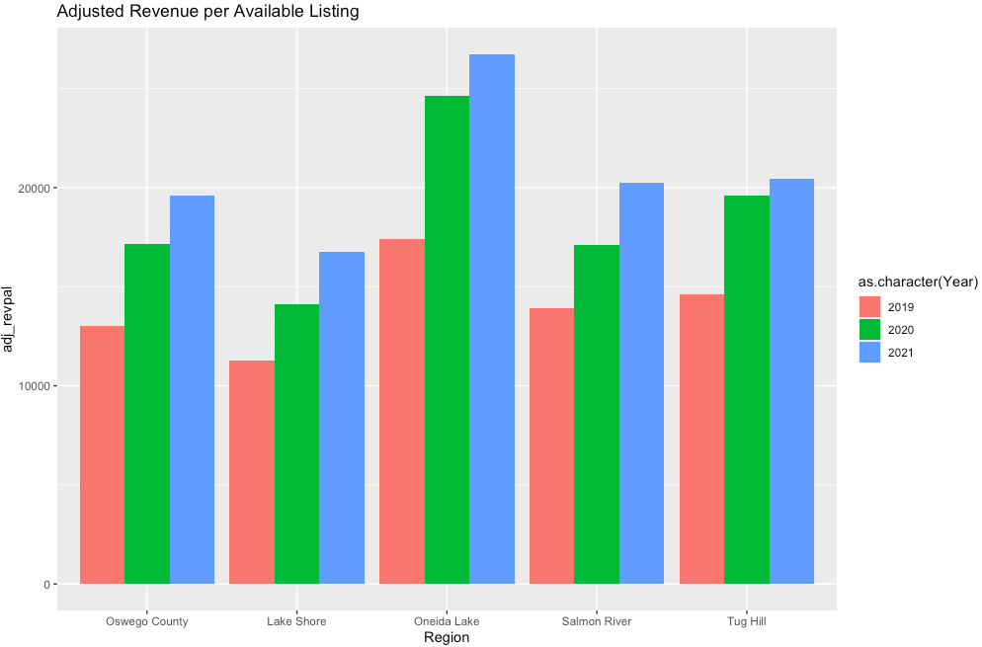
Year-to-year Adjusted Revenue per Available Listing
26737
24640
Adjusted Revenue per Available Listing: Average revenue per available listing over the reporting period adjusted for blocked nights.
20267
20467
19621
19599
17137
16768
17383
17103
14104
13924
14615
12998
11252
Notes:
For average revenue per listing, the number also increased by year despite the present of Covid. Interestingly, Oneida lake outnumbered other subregions, and even the big region Oswego County. In 2019, Oneida Lake earned 17 thousand dollars, compared to less than 15 thousand dollars of other regions. Similarly, 2020 and 2021 of Oneida Lake also had a few thousand higher income than the rests.

Slide 32
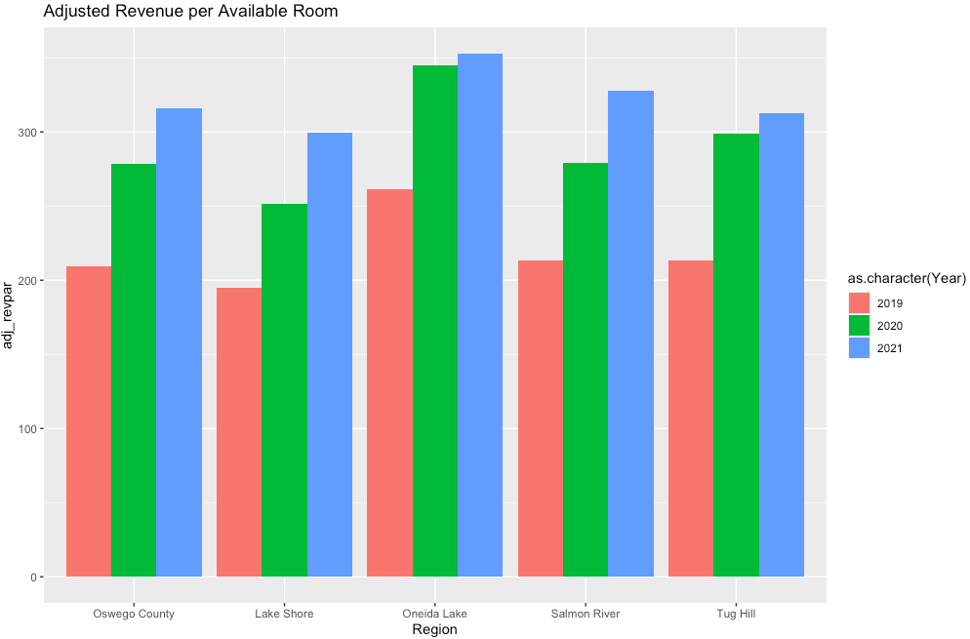
Year-to-year Adjusted Revenue per Available Room
353
345
316
328
313
299
299
Average revenue per available room adjusted for blocked nights from year to year. Gross revenue/available_room_nights
278
279
252
262
210
214
213
195
Notes:
For yearly average earning per room, the trend is identical to the yearly average revenue per listing.

Slide 33

Conclusion
From the graphs, we see that even though COVID was present, the number of bookings and the revenue still increased compared to the previous years.That is it went up from 2019 to 2020 to 2021.
The month that had the most bookings was August, while the lowest month being January. For some reasons, March also had higher bookings compared to other low-booked months.
April was the month with the highest nights and room nights per book while October was the month with the least nights in this scenario.
The highest revenue was seen from the months of June to October.

Slide 34

THANK YOU !!!
Questions /comments

